Slide 1
Do Well Do Good
July 2019
Case 1

Slide 2
The 8 criteria of a “do well do good” company
Customers
Sell something you think will genuinely help your customer (people call it “purpose”)
Therefore don’t’ sell something that creates an addiction or harm your customers
Make your employees learn and grow.
Make an effort to offer job opportunities to those who are out of the traditional job market.
Be smart at finding an innovative and sustainable economic model, and not at avoiding taxes
Have operations that don’t impact the society negatively unless you more than offset them
If your product can change lives of people who are not your customers, make an effort to find an economic model to serve them as well (eg finance, health,)
Don’t’ sell/buy something to/from company that does not follow principles 1-6
Employees
Government
Society
Value chain

Slide 3
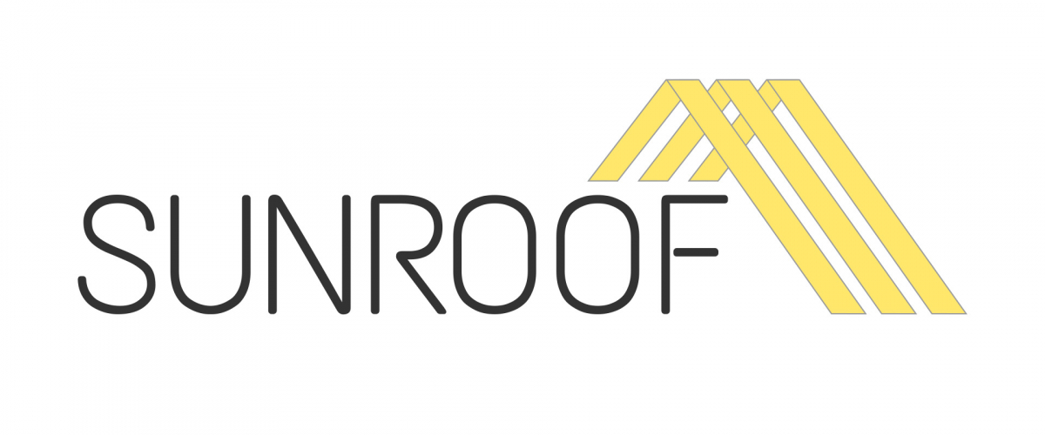
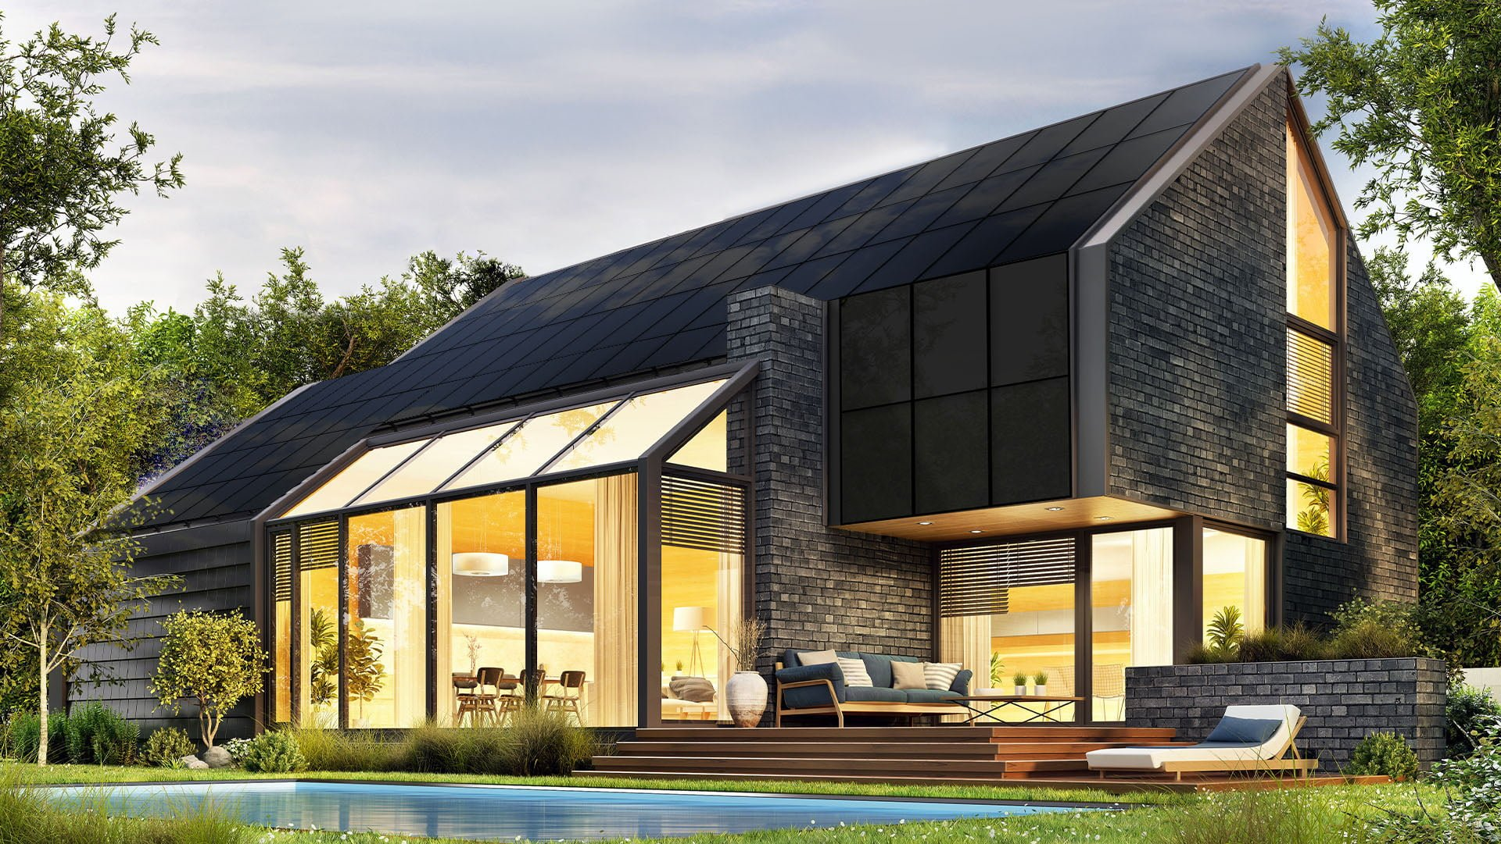
SunRoof https://sunroof.se/en/
Background of the company
Criteria
Description
SunRoof is an eight-year-old(2013), Sweden-based company that installs smart rooftops that produce solar power, as well as enables its customers to share surplus energy. It has raised €4.5 million in extended seed funding
Criteria 1
They protect, insulate and ventilate houses, and produce electricity at the same time
Criteria 2
Roofs are not harmful to anybody and can’t create addiction.
Criteria 6
It has the lowest carbon footprint in the world. Maintains a harmonious relationship between three aspects that are key for man: comfort, energy, and the environment
Criteria 8
Smart innovative solution that affects the society and environment positively.
Product/ service
Characteristics
simple, lightweight, and easy to install
eye-catching modern look and the ultra-smooth solar panel surface
lowest carbon footprint
electricity produced by SunRoof

